Slide 1

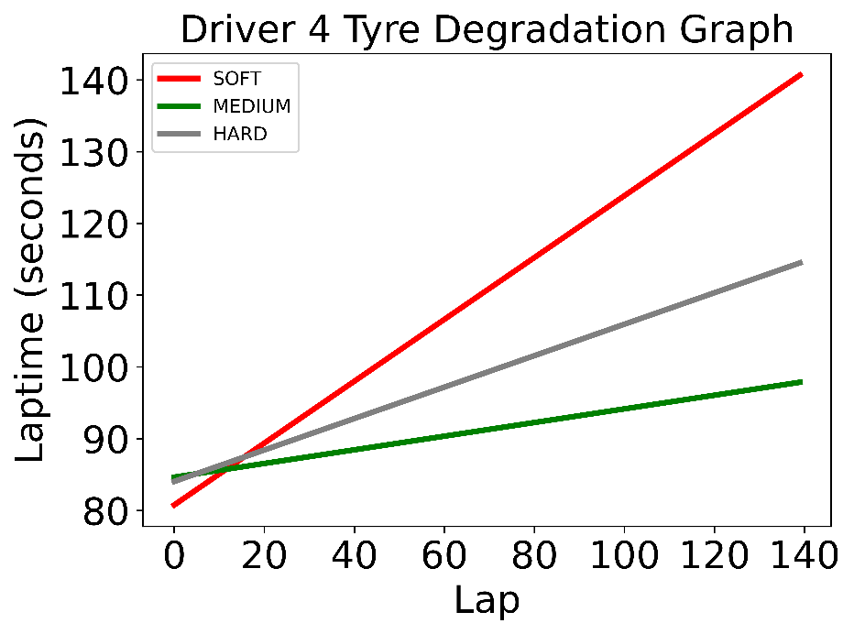
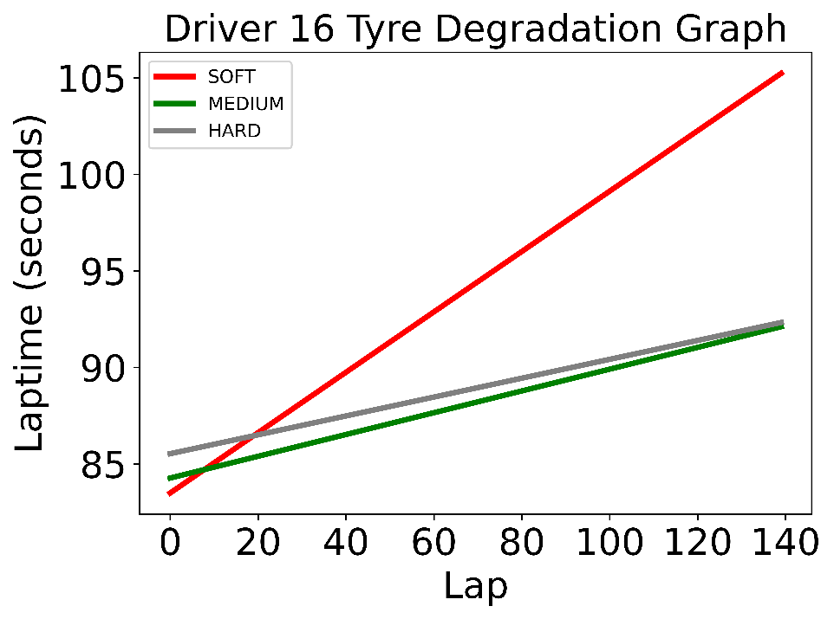
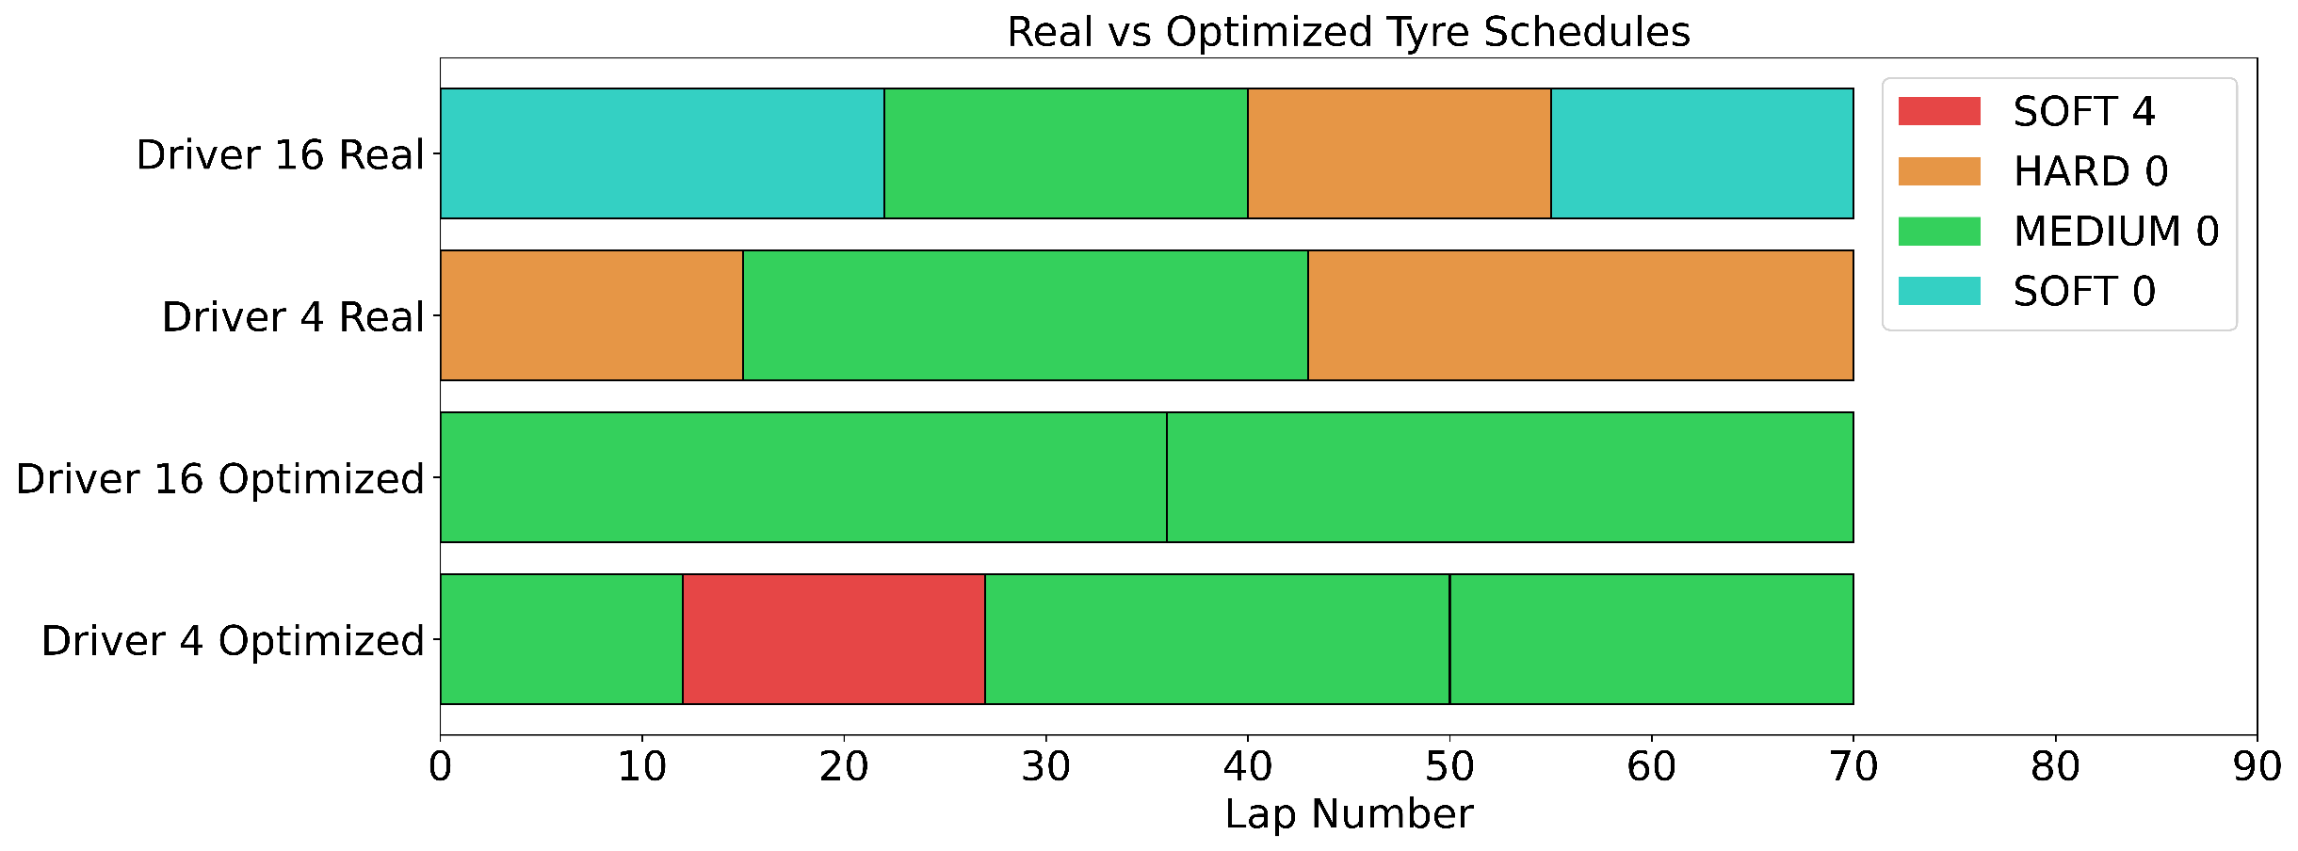
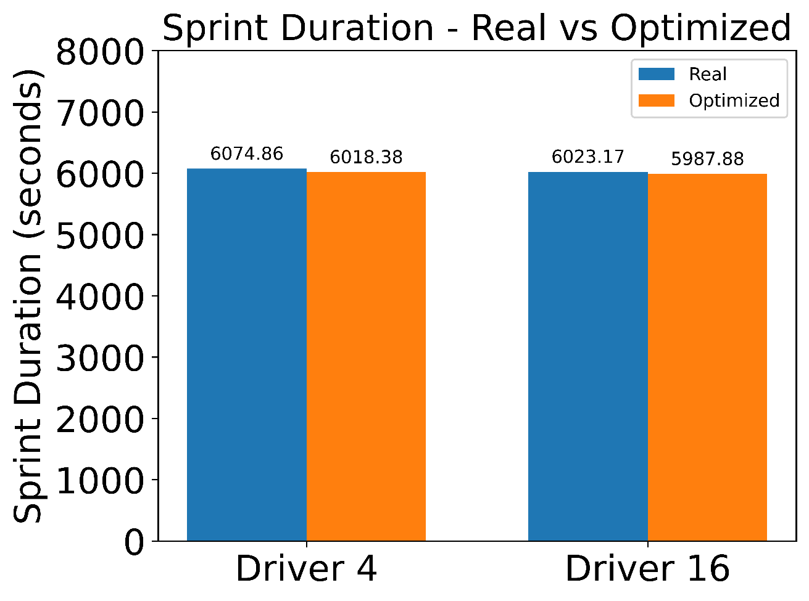
Optimization of Tyre Selection and Pit Stop Strategies
Christopher Quinn (CCSE)
Demetrios Kriezis (EECS)
Executive summary
What are the data?
What is the impact?
We formulated and implemented a binary optimization problem that returns the optimal pit stop strategy and tyre choice that minimizes the sprint duration time of a Formula One racing session.
Teams can in real-time or ahead of time, decide on a pit stop strategy and corresponding tyre choice based on past data and current tyre constraints.
The race car driver can better prepare to
Problem statement
Laptimes per were extracted from the data above
The pit stop time is an average pit stop time
Minimize the sprint duration
Enforce no pit stops for lap 1
Make sure that
What are the key findings?
If you had another week, what would you do?
Obtain realistic time estimates from a formula one simulator and generate a better data set.
OR
Incorporate robust optimization modeling to introduce uncertainties in the data. Uncertainties can come from:
Weather conditions.
Crashes from other drivers and road obstructions.
Other
OR
Introduce non-linearity into data from the weight of the vehicle getting lighter due to fuel consumption, which depends on the previous tyre choices since the fuel consumption depends on the elapsed time.
Why do we care?
Tyre choice can shave seconds from a driver’s total time
Seconds can influence the difference between
To increase our chance of winning a race, or at the very least ranking higher in a race session
To increase our chance of placing higher in the qualifying session to gain an advantage in the actual race
Sponsorship money
Fame and Glory!
15.071—The Analytics Edge Fall 2019
15.093—Optimization Fall 2022

